Slide 1
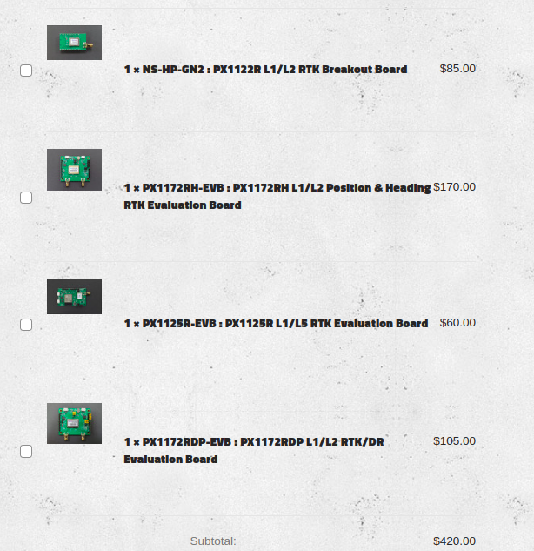
I ordered these from Navspark
The idea is to test these to see how they compare to my current setup.
1. Use a pair to get the lat, lon for the 435 Pine Valley NTRIP location.
2. Make an NTRIP server/caster at 435 Pine Valley.
2. See if the 435 PV NTRIP can service 62 Collins Drive
3. Test the unit that provides heading using 2 antennae inputs
4. Test the unit that provides localization in GPS starved areas

